Slide 1
How To Design Your Custom NGS Panel

Slide 2
Content
01
Create a Nonacus account
05
Create a panel design from a template (genes or regions)
02
Create a panel design
06
Panel design downloads
03
Create a panel design from a BED file
07
Share a panel design
04
Create a panel design from a gene list
08
FAQs

Slide 3
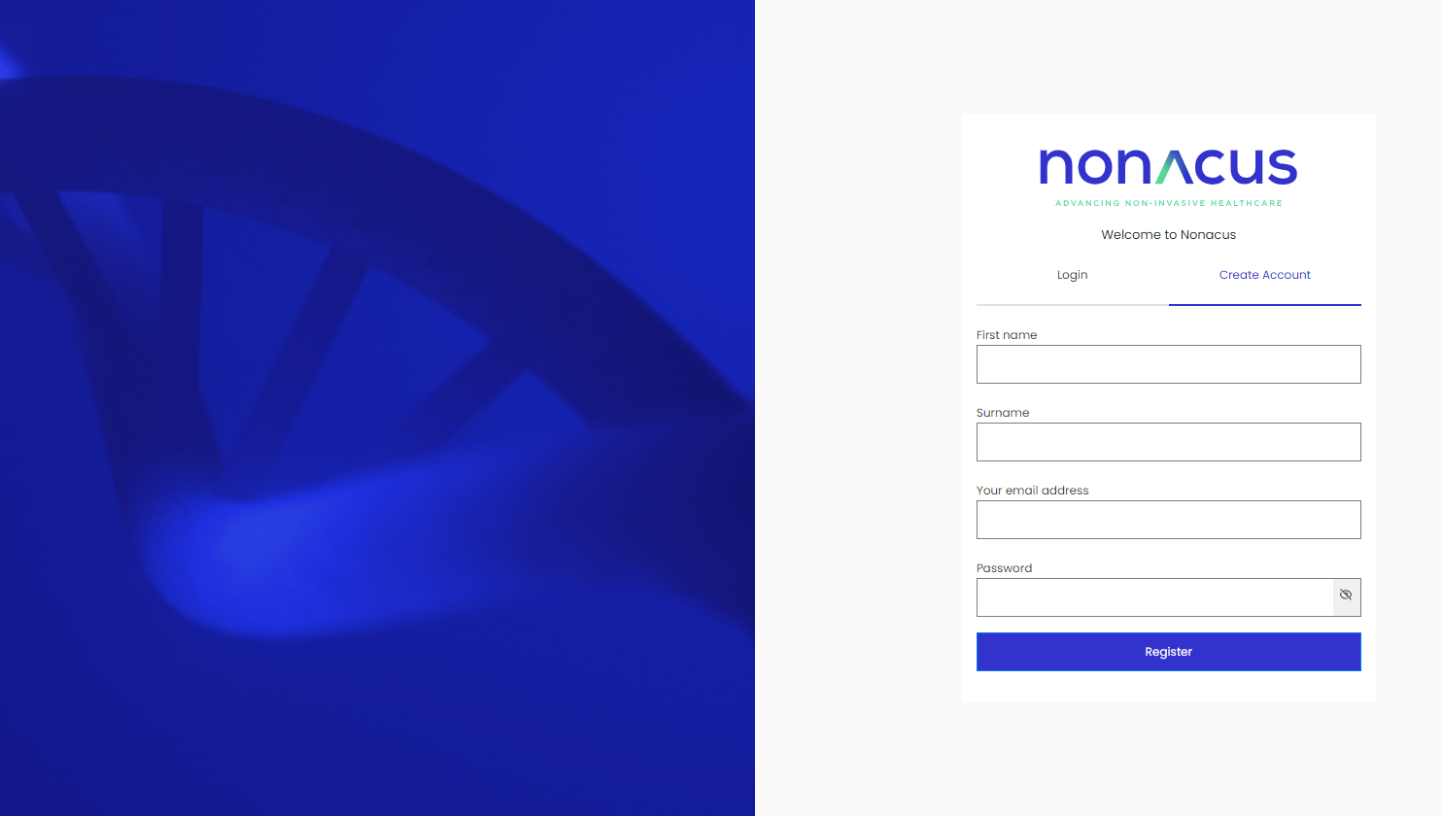
How to design your Custom NGS Panel
1. Create a Nonacus Account
Go to https://www.nonacus.com/
On the opening page click Panel Design Tool on the upper right
Or alternatively, go direct to https://mynonacus.nonacus.com/
Click ‘Create Account’

Slide 4
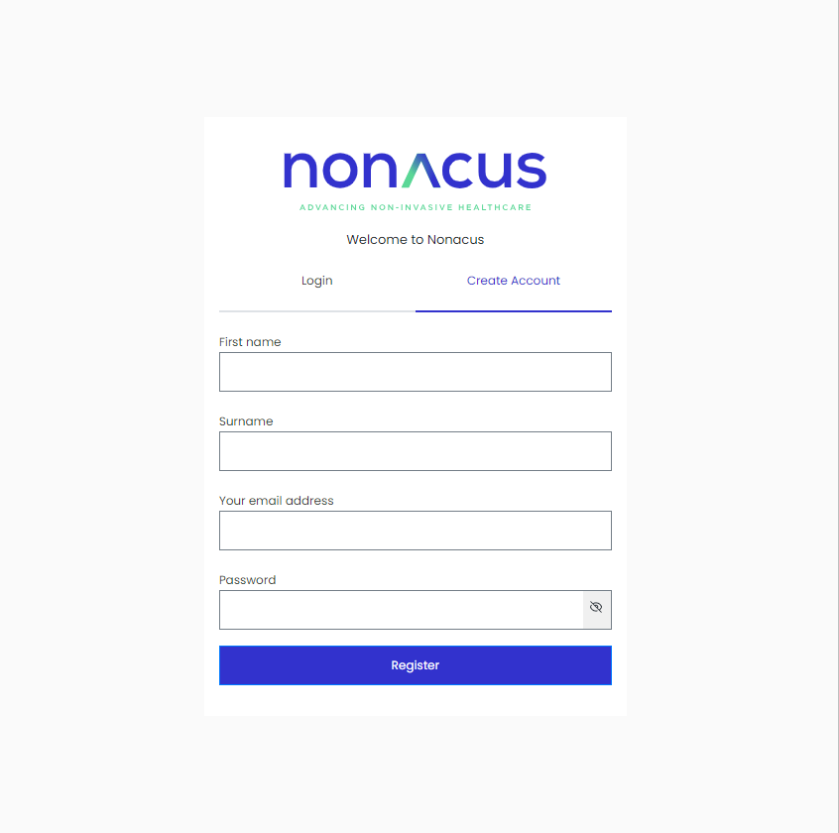
How to design your Custom NGS Panel
1. Create a Nonacus Account
Fill in First Name, Surname, professional email account, setup your own password and click Register

Slide 5
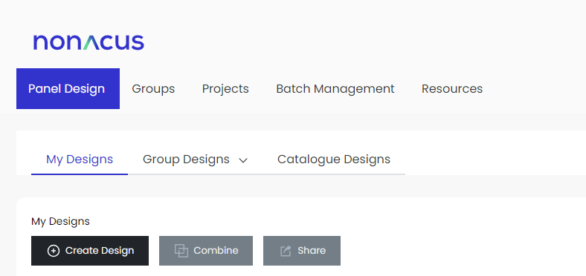
How to design your Custom NGS Panel
2. Create your own Custom NGS Panel
After registration, click Login, enter your email address, password and click Continue
On the Nonacus Probe Design Tool page, click Create Design

Slide 6
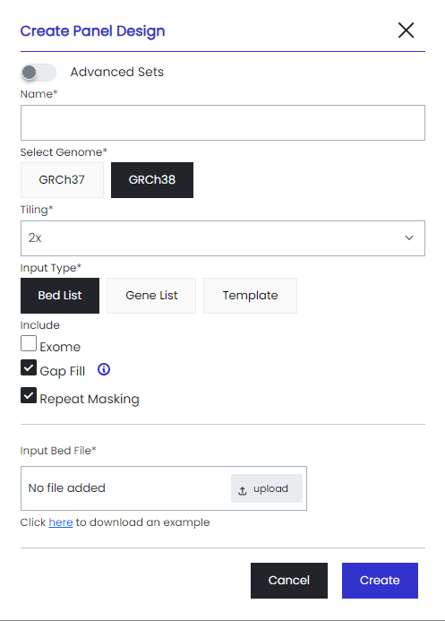
How to design your Custom NGS Panel
2. Overview of the ‘Create Panel Design’ page
‘Advanced’ setting provides more tiling options if required.
Name your panel
Select the Genome Option (GRCh37 or GRCh38)
Tiling sets the preferred probe alignment/overlap
Select Input Type: BED list, Gene List or Template ('Template' allows a mix of genes and regions in a design).
Selecting Exome will choose validated probes from the Nonacus exome, that are appropriate for the Genes/Regions specified
Selecting Gap Fill will utilise validated probes from the Nonacus exome in drop out/masked regions.
Repeat Masking will mask difficult to target repetitive regions
Browse your input file

Slide 7
How to design your Custom NGS Panel
3. Create a Panel Design using a BED file
Name your panel
Select the Genome Option (GRCh37 or GRCh38)
Select the preferred tiling
Select Input Type: BED list
Browse the file to upload it and click Create
Note: Click here to download an example of a BED file
The design will be validated and an email will be sent explaining the next steps.

Slide 8
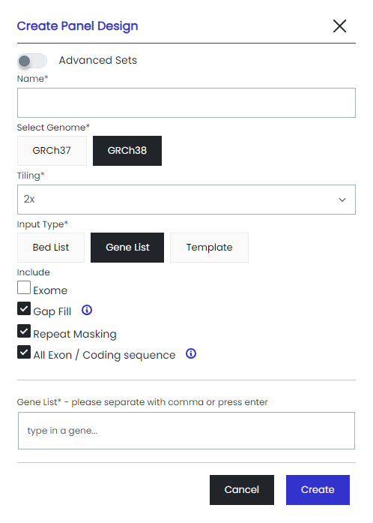
How to design your Custom NGS Panel
4. Create a Panel Design using a Gene List
Name your panel
Select the Genome Option (GRCh37 or GRCh38)
Select the preferred tiling
Select Input Type: Gene List
All Exon/Coding sequence: Select this toggle for coding sequence only, de-select for all exons including 3' and 5' untranslated regions
Enter your list of genes in the Gene list box, one per line
Click Add
The design will be validated and an email will be sent explaining the next steps.

Slide 9
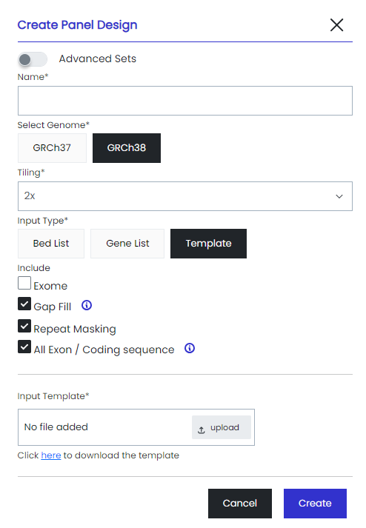
How to design your Custom NGS Panel
5. Create a Panel Design using a Template File
A template file lets you specify a mixture of gene and regions in one file, enabling an easy way to specify sophisticated custom panels.
Name your panel
Select the Genome Option (GRCh37 or GRCh38)
Select the preferred tiling
Select Input Type: Template
All Exon/Coding sequence: Select this toggle for coding sequence, de-select for all exons including untranslated region
Browse the file to upload it and click Add
Note: Click here to download an example of a Template file
The design will be validated and a notification email will be sent explaining the next steps.

Slide 10
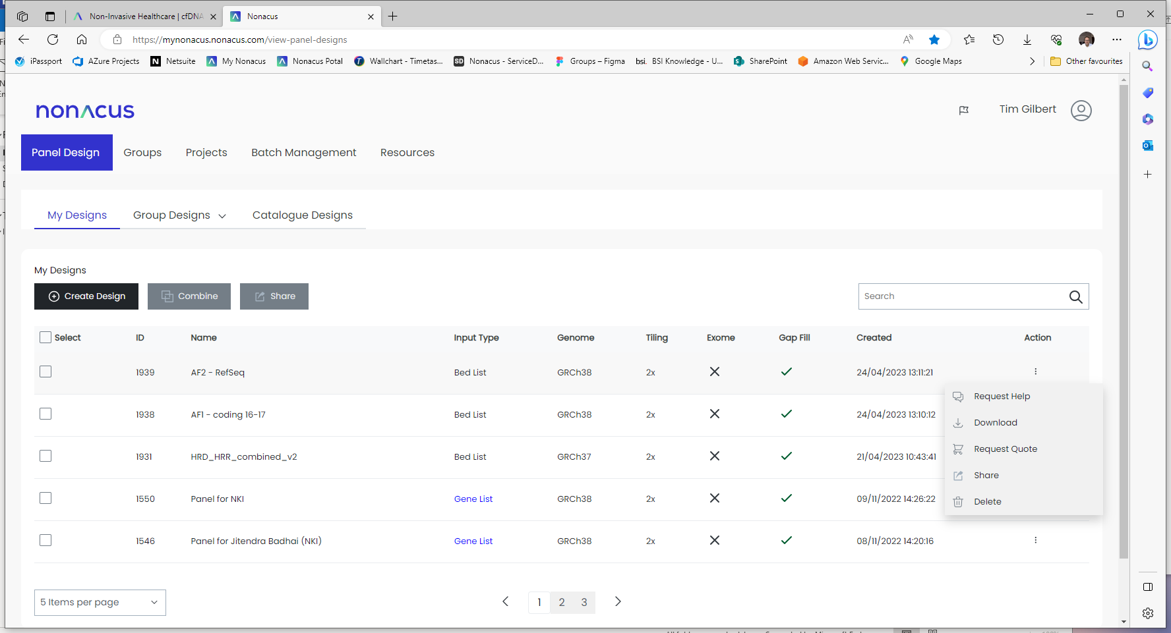
How to design your Custom NGS Panel
6. Downloading your Panel Design stats
Each panel design generates 3 BED files; covered regions, non-covered and target regions and a ‘design stats’ PDF which shows target coverage and probe information.
DESIGN REPORT
DESIGN INFORMATION
Design ID: XXXX
Design Name: XXXXXXXX
Genome Build: GRCh38
TARGET INFORMATION
Total Target Size (bp): XXXX
Number of Merged targets: XX
PROBE INFORMATION
Total Number of Probes: XXX
Total Covered Region (bp): XXXXXX
Total Covered (%): 100.0
Total Not Covered (%): 0.0
Find the panel you wish to view the design stats for
Click the Actions ellipsis ‘…’ and choose Download. Files will be downloaded to your ‘Downloads’ folder

Slide 11
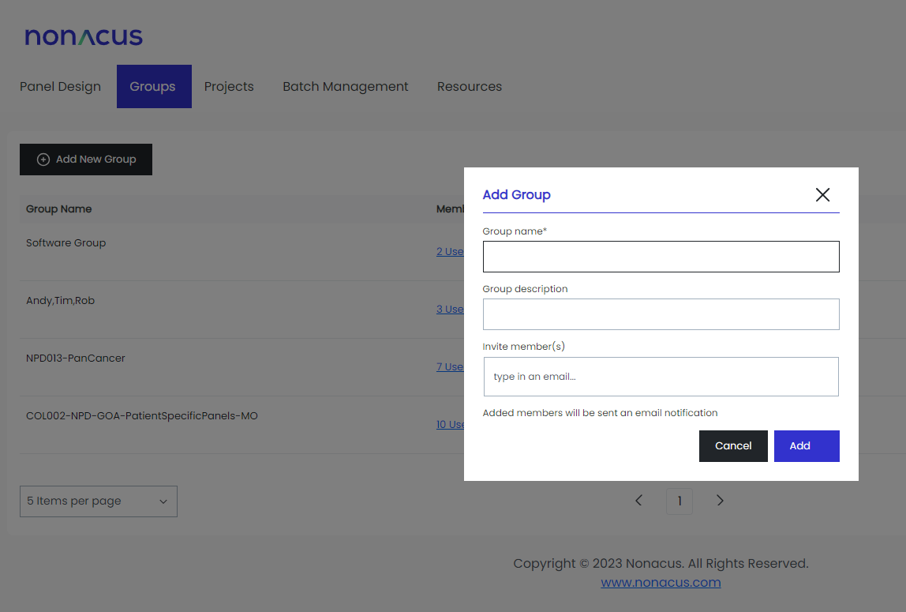
How to design your Custom NGS Panel
7. How to create a group to share your panel designs
Select the Groups tab
Click on ‘Add new group’
Give your group a name
Add each member’s email address
Click ‘Add’

Slide 12
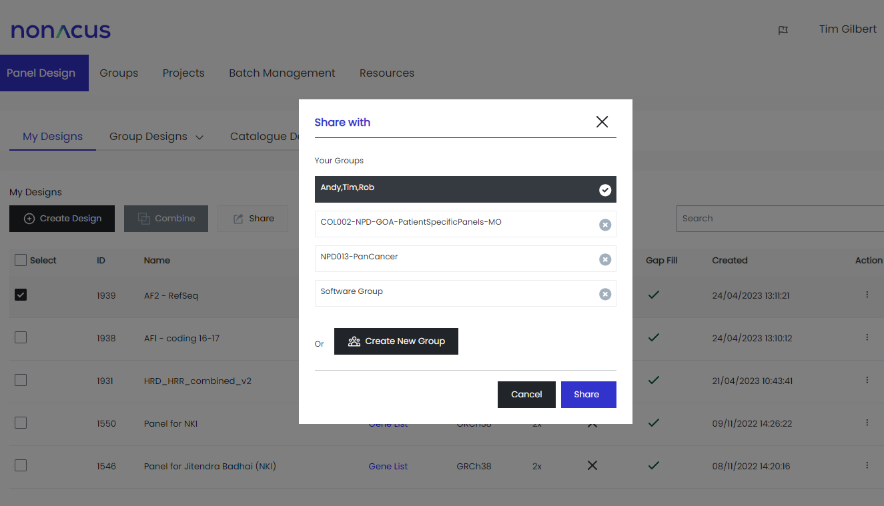
How to design your Custom NGS Panel
7. How to share your panel designs
Select the panel(s) you wish to share
Click the share button
Select the group(s) you wish to share with
Click ‘Save’
An email will be sent to all the members of the group notifying them that a panel has been shared with them.

Slide 13
FAQs
Q: Why has my design failed?
A: You may have entered an incorrect gene name (please check you are using NCI naming convention), if you entered a gene list, make sure its in the right format – ie a list not in a line. If none of these work, please contact tech support: support@nonacus.com
Q: How do I find out how well the design covers my regions?
A: A pdf file called 'design stats' which contains information about your panel including percentage coverage can be downloaded by clicking the Actions ellipsis associated with your panel.
Q: My coverage is less than 100% how do I find out which regions are missing?
A: Download the BED file labelled 'covered' for your panel design. The BED file can be found by clicking the Actions ellipsis associated with your panel.
Q: I have some really important regions missing from my design – how can I get these covered?
A: Our design algorithm automatically masks highly repetitive regions of the genome to improve panel success and prevent excess capture and sequencing cost associated with these regions. If you have a region important to your work that is being masked and preventing probe design across that region, please contact technical support (support@nonacus.com) who can help you improve coverage.

Slide 14
FAQs
Q: How much will my panel cost?
A: You can request a quote by clicking the Actions ellipsis associated with your panel. We price panels based on the number of probes in the panel:
Catalogue number | Product Description | Number of probes
C3448CU | Cell3TM Target: Custom Panel, Tier 1 (48 samples) | 10,000
C3496CU | Cell3TM Target: Custom Panel, Tier 1 (96 samples) | 10,000
C3548CU | Cell3TM Target: Custom Panel, Tier 2 (48 samples) | 20,000
C3596CU | Cell3TM Target: Custom Panel, Tier 2 (96 samples) | 20,000
C3648CU | Cell3TM Target: Custom Panel, Tier 3 (48 samples) | 50,000
C3696CU | Cell3TM Target: Custom Panel, Tier 3 (96 samples) | 50,000
C3748CU | Cell3TM Target: Custom Panel, Tier 4 (48 samples) | 100,000
C3796CU | Cell3TM Target: Custom Panel, Tier 4 (96 samples) | 100,000

Slide 15
Quinton Business Park, Unit 5, 11 Ridgeway,
Quinton, Birmingham, B32 1AF, United Kingdom
T. 98 345 543 432
nonacus.com

